Slide 1
3:10-18

Slide 2
3:10-18
World ~ kosmos – The system that sets itself up as independent from God

Slide 3
3:10-18

Slide 4
3:10-18
Past
Present
Future
Present participle
I am (not) practicing and continue to (not) practice
John 8:44 ~ You are of your father the devil, and the desires of your father you want to do. He was a murderer from the beginning, and does not stand in the truth, because there is no truth in him. When he speaks a lie, he speaks from his own resources, for he is a liar and the father of it.

Slide 5
3:10-18
Gal. 5:22-23 ~ ²² But the fruit of the Spirit is love, … ²³ … Against such there is no law.

Slide 6
3:10-18

Slide 7
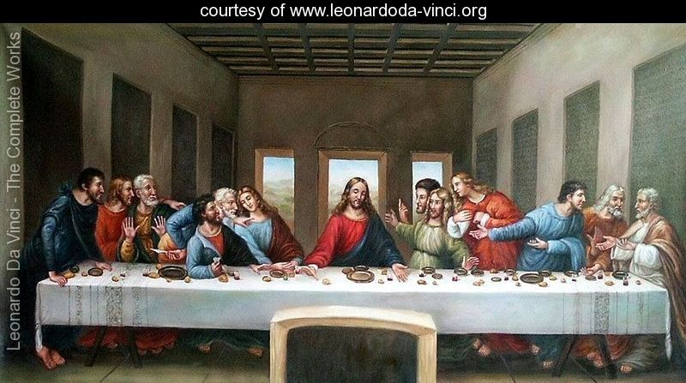
3:10-18

Slide 8
3:10-18
Mark 3:17 ~ James the son of Zebedee and John the brother of James, to whom He gave the name Boanerges, that is, “Sons of Thunder”;
Luke 9:54 ~ And when His disciples James and John saw this, they said, “Lord, do You want us to command fire to come down from heaven and consume them, just as Elijah did?”

Slide 9
3:10-18

Slide 10
3:10-18
Have passed ~ metabainō – meta, to change; basis, foot (sole of)
Perfect tense ~ passed, never to have to pass again
Past
Present
Future
Perfect
I have passed and continue to pass

Slide 11
3:10-18

Slide 12
3:10-18
C. H. Spurgeon ~ “I have heard it said, by those who would be thought philosophers, that in religion we must believe, but cannot know. I am not very clear about the distinction they draw between knowledge and faith, nor do I care to enquire; because I assert that, in matters relating to religion, we know; in the things of God, we both believe and know.”

Slide 13
3:10-18

Slide 14
3:10-18
Matt. 5:21-24 ~ ²¹ You have heard that it was said to those of old, ‘You shall not murder, and whoever murders will be in danger of the judgment.’ ²² But I say to you that whoever is angry with his brother without a cause shall be in danger of the judgment. And whoever says to his brother, "Raca!" shall be in danger of the council. But whoever says, ‘You fool!’ shall be in danger of hell fire. ²³ Therefore if you bring your gift to the altar, and there remember that your brother has something against you,

Slide 15
3:10-18
Matt. 5:21-24 ~ ²⁴ leave your gift there before the altar, and go your way. First be reconciled to your brother, and then come and offer your gift.

Slide 16
3:10-18

Slide 17
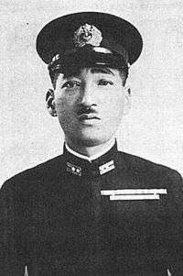
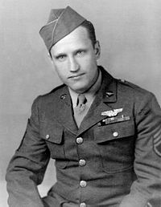
3:10-18
Mitsuo Fuchida
Jake DeShazer

Slide 18
3:10-18

Slide 19
3:10-18
Life ~
not bios (manner of living, physical life)
or zōē (intrinsic life)
but psuchē (soul)
Rom. 5:8 ~ But God demonstrates His own love toward us, in that while we were still sinners, Christ died for us.

Slide 20
3:10-18

Slide 21
3:10-18
Heart ~ KJV, bowels

Slide 22
3:10-18

Slide 23
3:10-18
Horace Bushnell (1802-1876) – “The more a man denies himself, the more shall he obtain from God.”

Slide 24
3:10-18

